Slide 1
Numbering System

Slide 2
Number System
Number System are the technique to represent numbers in computer system architecture.
Every value that you are saving or getting into/from computer memory has a defined number system.
Computer architecture supports different number systems.

Slide 3
Number Systems
Decimal
Counting fingers base 10 system
Binary
For computers since fipflop store either 0 or 1 base
(0,1)
Octal
To shorten ong binary numbers base 8(0-7)
Hexadecimal
Since data is stored in bytes base 16(0-9,A-F)

Slide 4
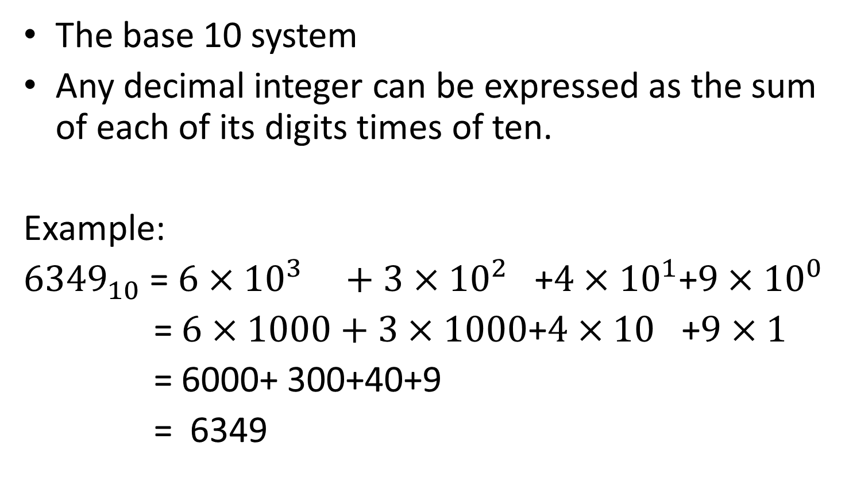
Decimal Numbers
The base 10 system
Any decimal integer can be expressed as the sum of each of its digits times of ten.
Example:
${6349}_{10}$ = $6×{10}^{3} +3×{10}^{2}$ +$4×{10}^{1}$+$9×{10}^{0}$
= $6×1000+3×1000$+$4×10$ +$9×1$
= 6000+ 300+40+9
= 6349

Slide 5
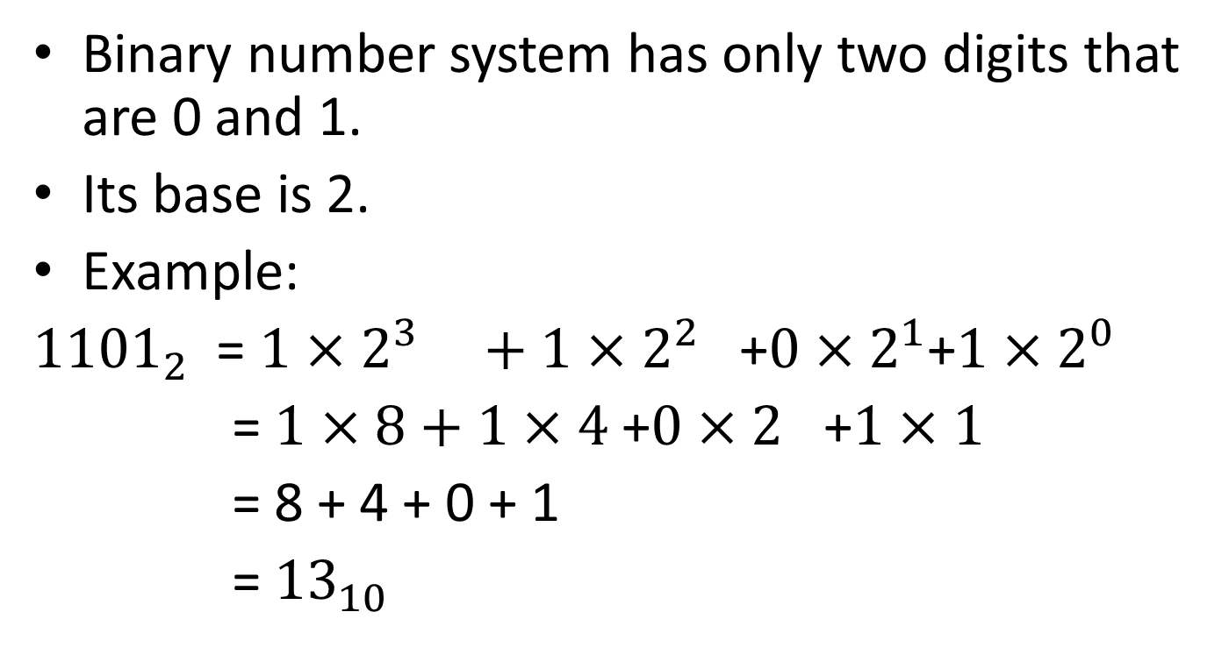
Binary Numbers
Binary number system has only two digits that are 0 and 1.
Its base is 2.
Example:
${1101}_{2}$ = $1×2^{3} +1×2^{2}$ +$0×2^{1}$+$1×2^{0}$
= $1×8+1×4$+$0×2$ +$1×1$
= 8 + 4 + 0 + 1
= ${13}_{10}$

Slide 6
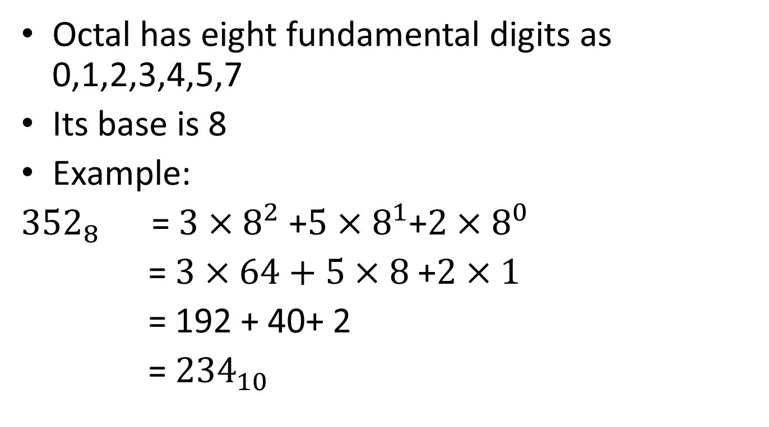
Octal Numbers
Octal has eight fundamental digits as 0,1,2,3,4,5,7
Its base is 8
Example:
${352}_{8}$ = $3×8^{2}$ +$5×8^{1}$+$2×8^{0}$
= $3×64+5×8$+$2×1$
= 192 + 40+ 2
= ${234}_{10}$

Slide 7
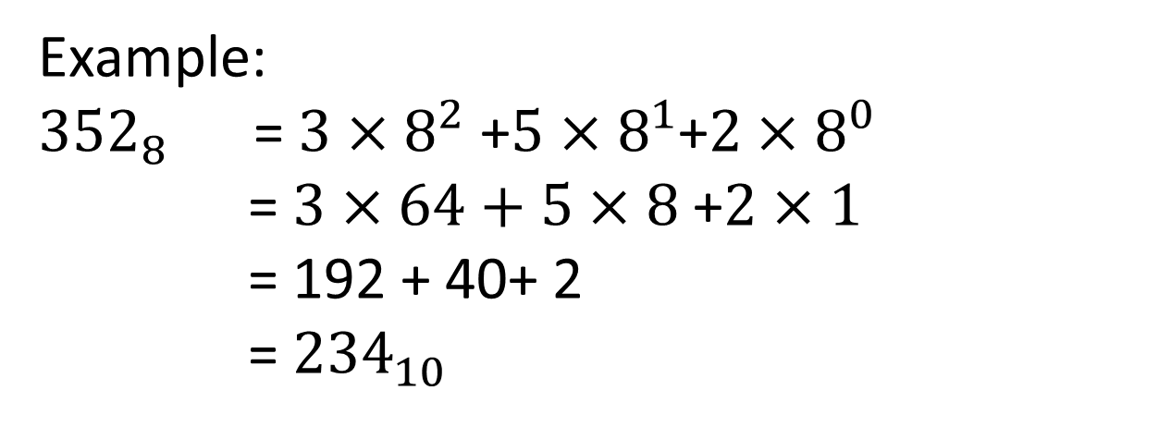
Hexadecimal Numbers
A hexadecimal number system has sixteen(16) alphanumeric values from 0 to 9 and A to F.
The base of hexadecimal number system is 16,because it has 16 alphanumeric values. Here,
A | B | C | D | E | F
10 | 11 | 12 | 13 | 14 | 15
Example:
${352}_{8}$ = $3×8^{2}$ +$5×8^{1}$+$2×8^{0}$
= $3×64+5×8$+$2×1$
= 192 + 40+ 2
= ${234}_{10}$

Slide 8
Number System Conversion
There are 03 rules.
Decimal number system to any number system (octal,binary,hexadecimal) use divison (/) method.
Decimal Binary(base 2)
Number division Octal (base 8)
(base 10) Hexadecimal(base 16)

Slide 9

Example:
${72}_{10}$ =$?_{2}$ ${ 72}_{10}$ =${1001000}_{2}$
2| 72
2 |36 – 0
2 |18 – 0
2 | 9 – 0
2 | 4 – 1
2 | 2 – 0
2 | 1 – 0
0 – 1

Slide 10
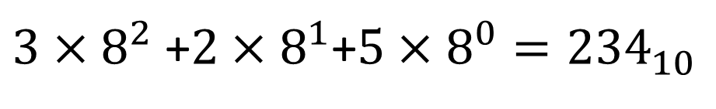
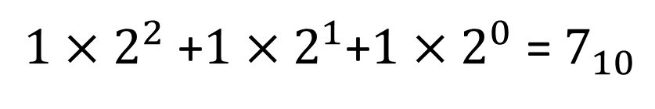
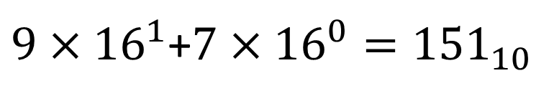
Any Number system (octal,binary,hexadecimal) to decimal number system use multification (x) method.
Binary(base 2) Multification Decimal
Octal (base 8) Number
Hexadecimal(base 16) (base 10)
$1×2^{2}$ +$1×2^{1}$+$1×2^{0}$ = $7_{10}$
$3×8^{2}$ +$2×8^{1}$+$5×8^{0}={234}_{10}$
$9×{16}^{1}$+$7×{16}^{0}={151}_{10}$

Slide 11
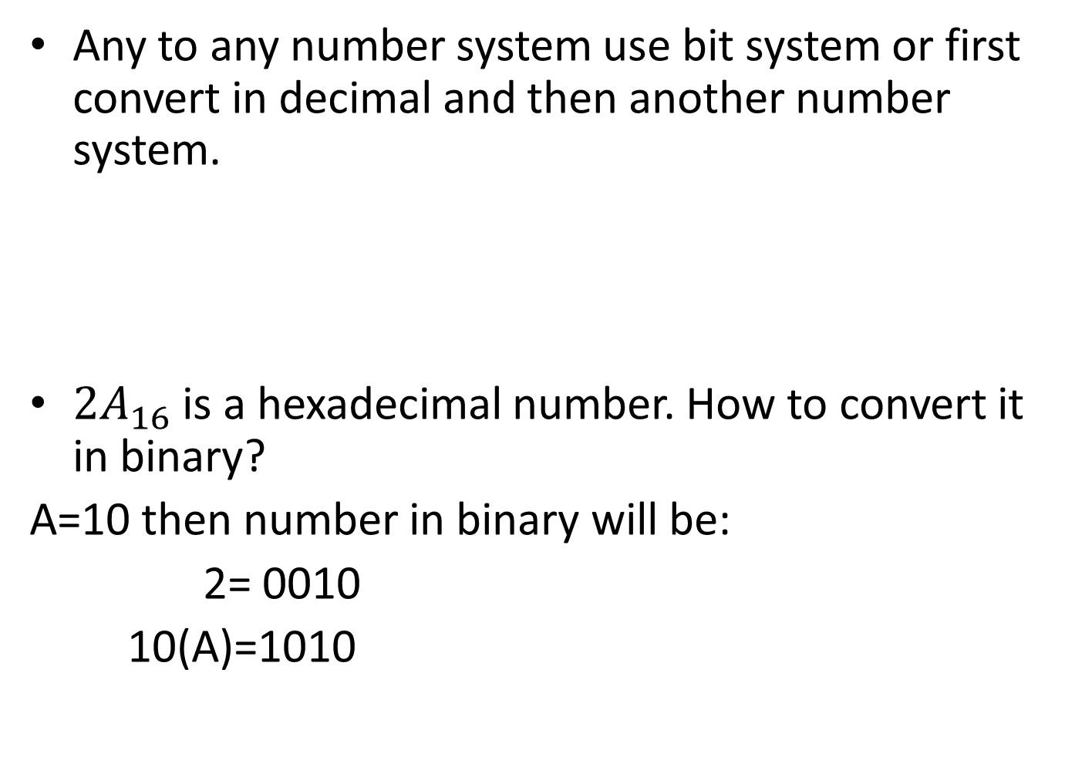
Any to any number system use bit system or first convert in decimal and then another number system.
${2A}_{16}$ is a hexadecimal number. How to convert it in binary?
A=10 then number in binary will be:
2= 0010
10(A)=1010
512 | 256 | 128 | 64 | 32 | 16 | 8 | 4 | 2 | 1

Slide 12
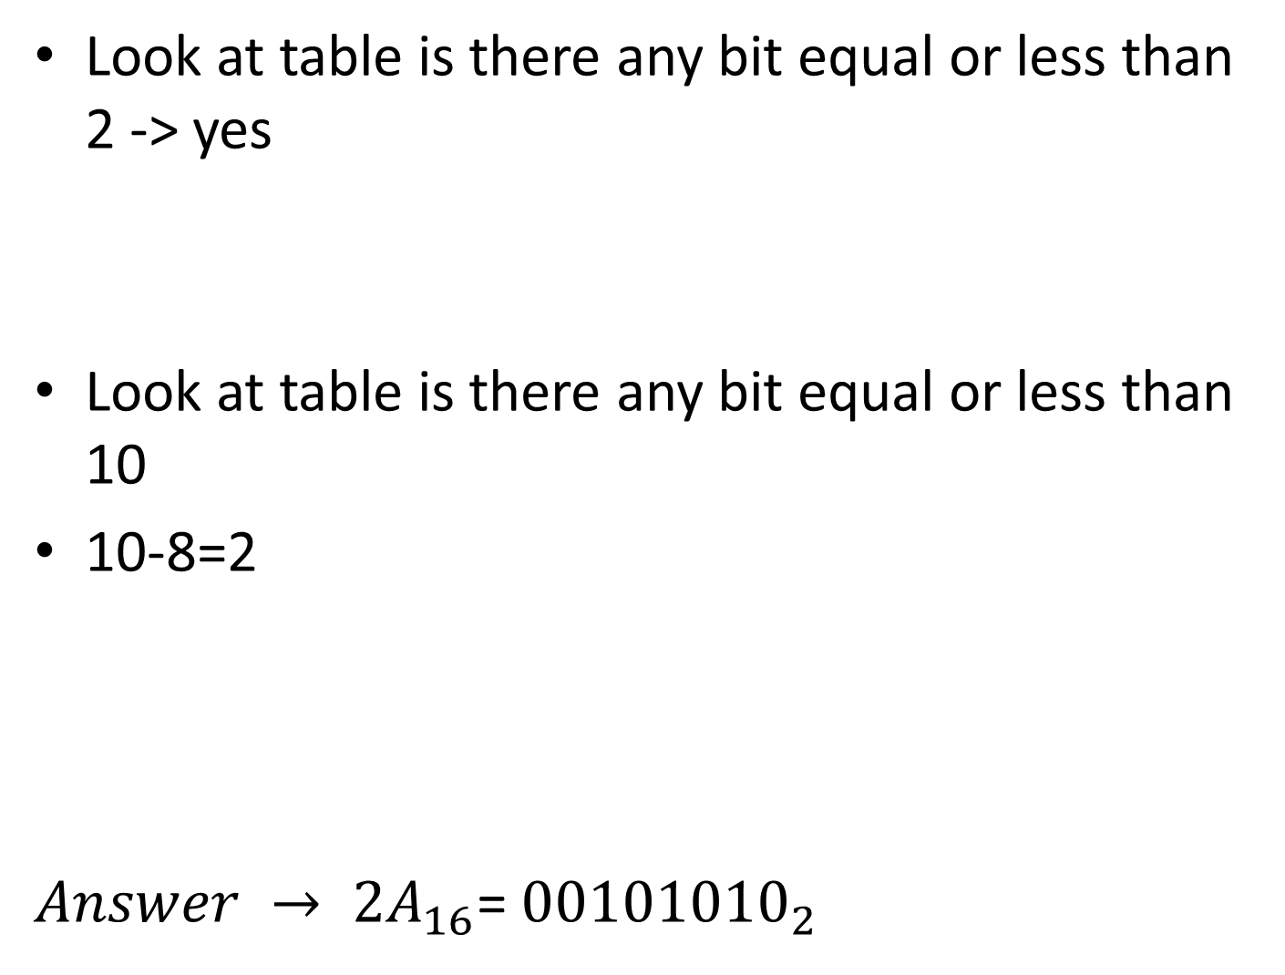
Look at table is there any bit equal or less than 2 -> yes
Look at table is there any bit equal or less than 10
10-8=2
${Answer → 2A}_{16}$= ${00101010}_{2}$
512 | 256 | 128 | 64 | 32 | 16 | 8 | 4 | 2 | 1
 |  |  |  |  |  | 0 | 0 | 1 | 0
512 | 256 | 128 | 64 | 32 | 16 | 8 | 4 | 2 | 1
 |  |  |  |  |  | 0 | 0 | 1 | 0
 |  |  |  |  |  | 1 | 0 | 1 | 0

Slide 13
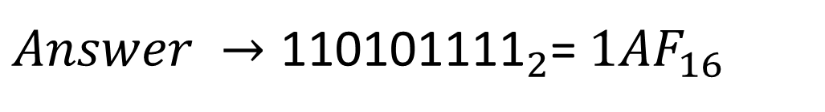

Binary to Hexadecimal
$2^{4}$= 16
Example
${\text{110101111}}_{2}$ -> $?_{16}$
$\text{ 000}\text{1} \text{1010} \text{1111}$
1
10
F
1
A
F
${Answer →\text{110101111}}_{2}$= ${1AF}_{16}$

Slide 14
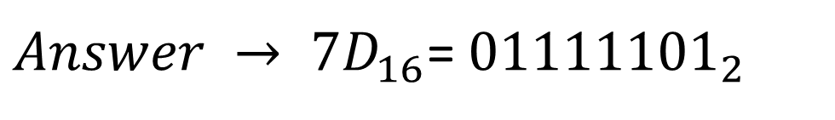

Hexadecimal to Binary
${\text{7}\text{D}}_{16}$ -> $?_{2}$
7-4 =3 -->
3-2 =1
13-8=5 -->
5-4=1
7 = 0111
13(D) = 1101
8 | 4 | 2 | 1
0 | 1 | 1 | 1
8 | 4 | 2 | 1
1 | 1 | 0 | 1
${Answer → 7D}_{16}$= ${01111101}_{2}$

Slide 15
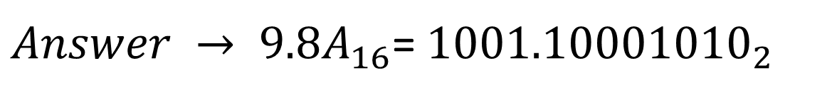

Hexadecimal Fractional to Binary
${9.8A}_{16}$ -> $?_{2}$
9=1001
8 = 1000
10 = 1010
A = 1010
8 | 4 | 2 | 1
1 | 0 | 0 | 1
1 | 0 | 0 | 0
1 | 0 | 1 | 0
${Answer → 9.8A}_{16}$= ${1001.10001010}_{2}$

Slide 16
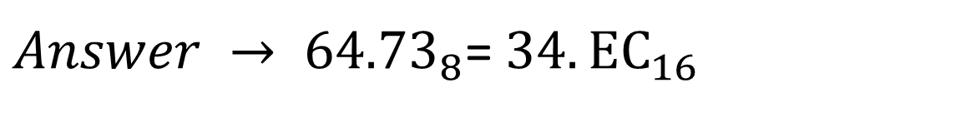
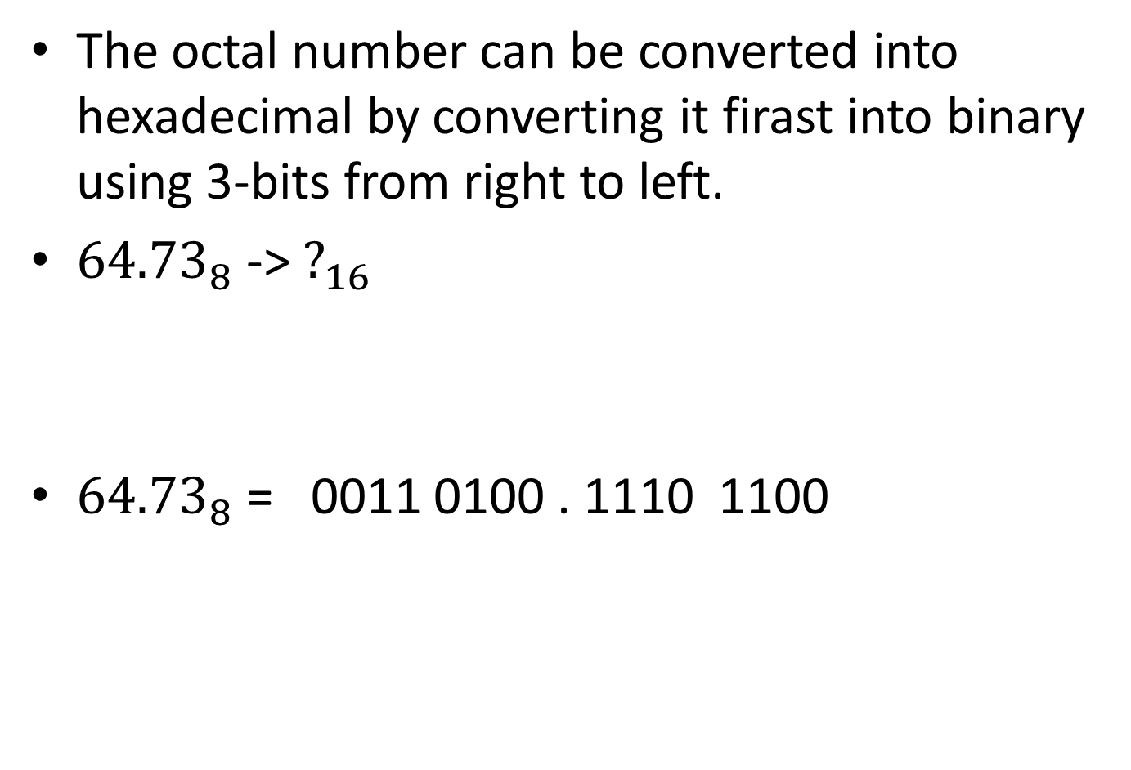
Octal to Hexadecimal
The octal number can be converted into hexadecimal by converting it firast into binary using 3-bits from right to left.
${\text{64.73}}_{8}$ -> $?_{16}$
${\text{64.73}}_{8}$ = 0011 0100 . 1110 1100
6=110
4=100
7=111
3=011
3
4
13
12
${Answer → 64.73}_{8}$= ${34.EC}_{16}$

Slide 17
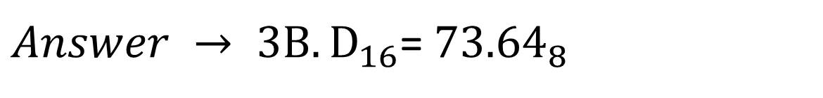

Hexadecimal to Octal
${\text{3}\text{B}\text{.}D}_{16}$ -> $?_{8}$
${\text{3}\text{B}\text{.}D}_{16}$ = 000 111 011 . 110 100
0
7
3
6
4
3 = 0011
B(11) = 1011
D(13) = 1101
${Answer → 3B.D}_{16}$= ${73.64}_{8}$

